Slide 1
Lesson 10
Airspace

Slide 2
Key References
https://www.faa.gov/regulations_policies/handbooks_manuals/aviation/phak/media/17_phak_ch15.pdf
https://www.faa.gov/air_traffic/publications/media/aim_bsc_w_chg_1_2_dtd_5-19-22.pdf

Slide 3
Overview & Objectives
Understand the U.S. National Airspace System
Be able to list and define all classes of U.S. airspace
Know VFR weather (visibility and cloud clearance), equipment, and ATC clearance requirements for each airspace
Be able to determine from a sectional map, what airspace a pilot is in at any point/altitude
Know sources for airspace study including Skyvector.com, the AIM, (and FARs Part 91 which is a later lesson)
Lesson Review & Summary
Questions
Quiz

Slide 4
Key Airspace Discussion
Airspaces are designated to support VFR, IFR, Military Training, GA, Airlines, etc.
Controlled airspace includes: A, B, C, D, E airspaces (maps/graphics later)
A = High ‘Altitude’ (18,000’ MSL/FL180 up to FL600) … IFR flight only
Airports w/ ATC control are B (‘Big & Busy’), C (‘Continuous Ops’), D (‘Daytime Tower’)
Key airspaces for VFR pilots for local training and XC are E and G
E is controlled airspace (read as ‘controllable’) airspace from 1201’ AGL to 17,999’ MSL (E varies)
G is ‘UNCONTROLLED’ airspace surface to 1200’ AGL (G also varies … more to follow)
Military Operations Areas: VFR military training (e.g., “Eagle MOA”)
Legal for VFR pilot to fly in with extremes caution if active … magenta hashed areas ///////
Restricted Areas: Military Weapons Ranges (e.g., “R-5303A”)
Pilots may not fly through restricted areas w/o ATC Clearance … blue hashed areas ///////
Prohibited Areas: Is what it says…don’t go there (e.g., “P-79”) … heavily marked/obvious
National Parks and Wildlife Refuges (“Buffalo Wildlife Refuge”) … dotted/circled/blue
No fly < 2,000’ AGL

Slide 5
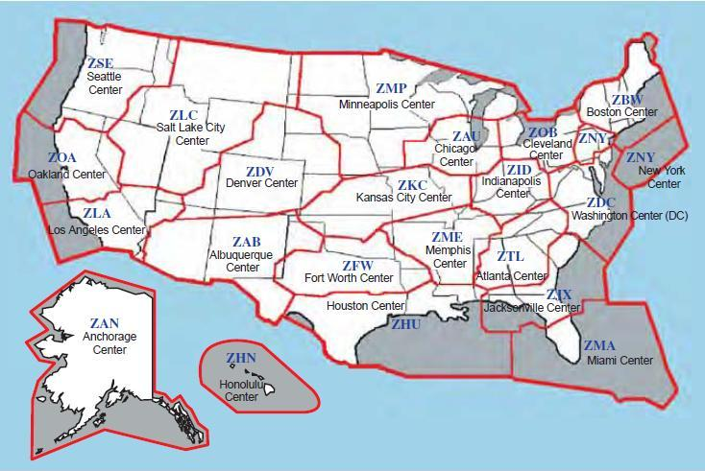
ATC ‘Center’ Boundaries (reference only)
We can use ATC Center or Regional Approach Controllers for ‘flight following’ during cross-country flights

Slide 6
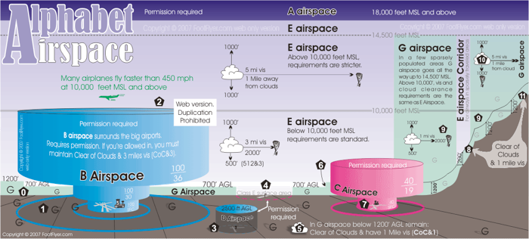
Airspace Aquarium

Slide 7
Airspace Table (Equipment/Entry/VFR Weather Requirements) - CRITICAL
Airspace
Equip & Entry Requirements (indicated if clnc/approval required)
Visibility
Distance from Clouds
A
Must be IFR …
B
Comm, Transponder w/Mode C, ADS-B, (+ ‘Clearance’ to Enter)
C
Comm, Transponder w/Mode C, ADS-B (must call approach prior to entry but clearance to enter WILL be granted)
D
Comm (must call tower prior to entry but clearance to enter WILL be granted)
Xpndr w/Mode C & ADS-B Req’d
E
Comm NOT required in Class E Hi/Lo
No Xpndr or ADS-B Req’d
G
No Comm/Transponder/ADS-B Req’d

Slide 8
Combined Airspace Info & Aquarium
Class A – IFR only – ‘Flight Levels’
(altimeter set to 29.92)
Class E
‘E Hi’ = 10K-17,999’MSL,
‘E Lo’ = <10K MSL)
VFR or IFR
(use local altimeter)
5-111
5-111
5-111
5-111
Day 1-152 (Night 3-152)
3-152
3-152
Day 1-152 (Night 3-152)
3-CLR
XPNDR
COMM
ADS-B
CLNC
3-152
COMM
XPNDR
ADS-B
Day 1-CLR
(Night 3-152)
3-152
COMM

Slide 9
Relating the Airspace Aquarium to the Sectional Map
On the following slides, we will look at several examples of airspace on sectional map excerpts.

Slide 10
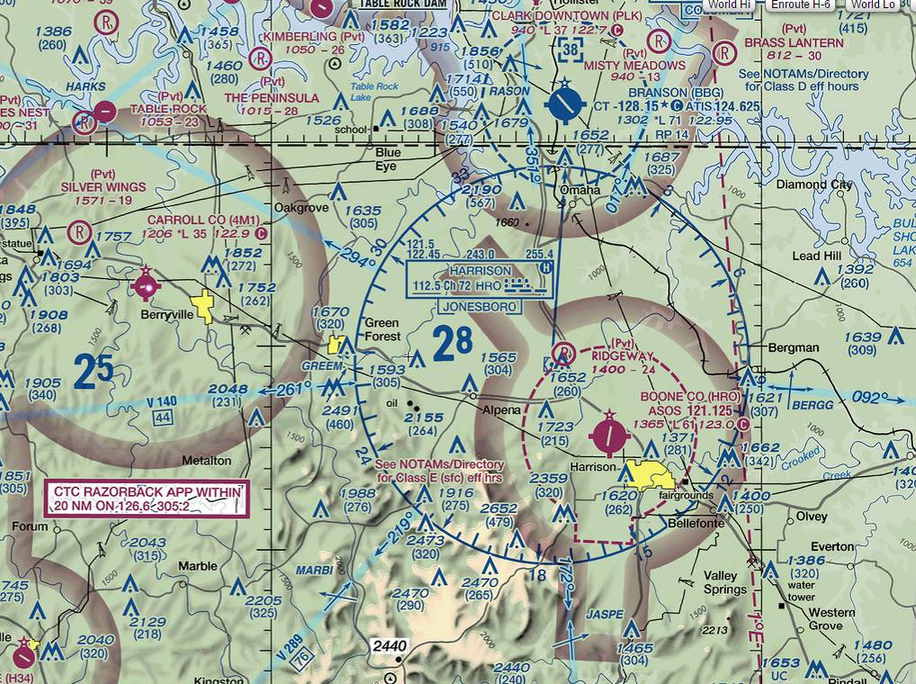
Identifying Airspaces on a Sectional Map
Class E
Class D
Class E Surface Area
Class E
Class E
- Solid lines generally identify full-time controlled airspaces (most airspace is full-time/does not change)
Dashed Line means part-time…call it “Dashed for Day only” (only Class D and Class E Surface areas)
Soft fat lines means that the airspace does not reach the surface (this is the “E Dip”)

Slide 11
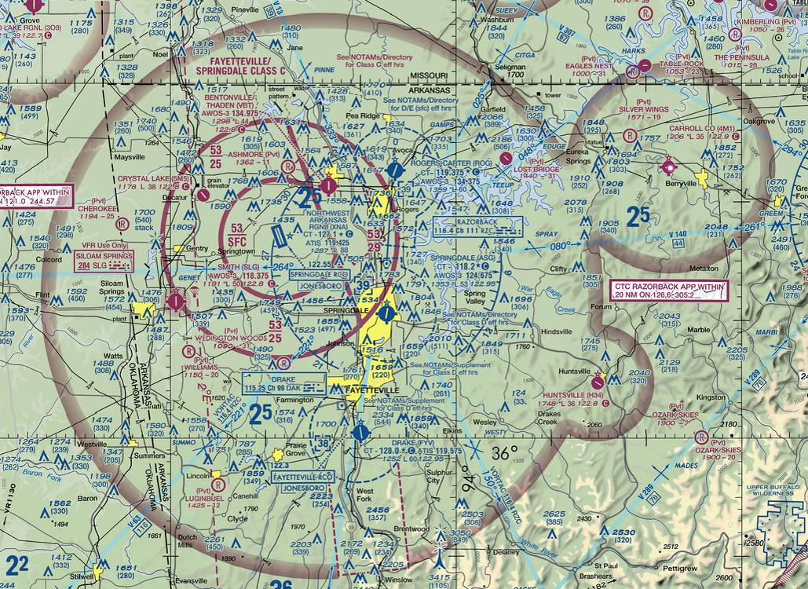
Identifying Airspaces (cont)
Class E
Class C
Class D
Class D
Note ‘Victor’ Airways (e.g., V-63 below) … pilots may file VFR flight plans on those routes
Class E
Class D
Wildlife Area

Slide 12
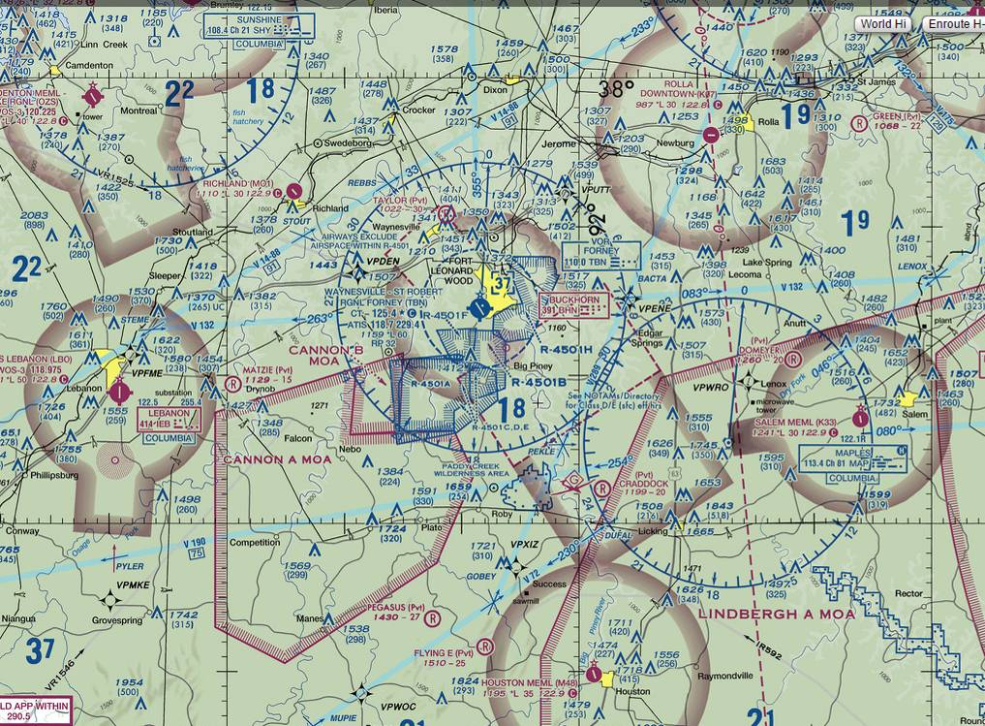
Identifying Airspaces (cont)
Class E
Class E
Class D
Class E
RESTRICTED AREAS
MOA
Class E
MOA
MOA

Slide 13
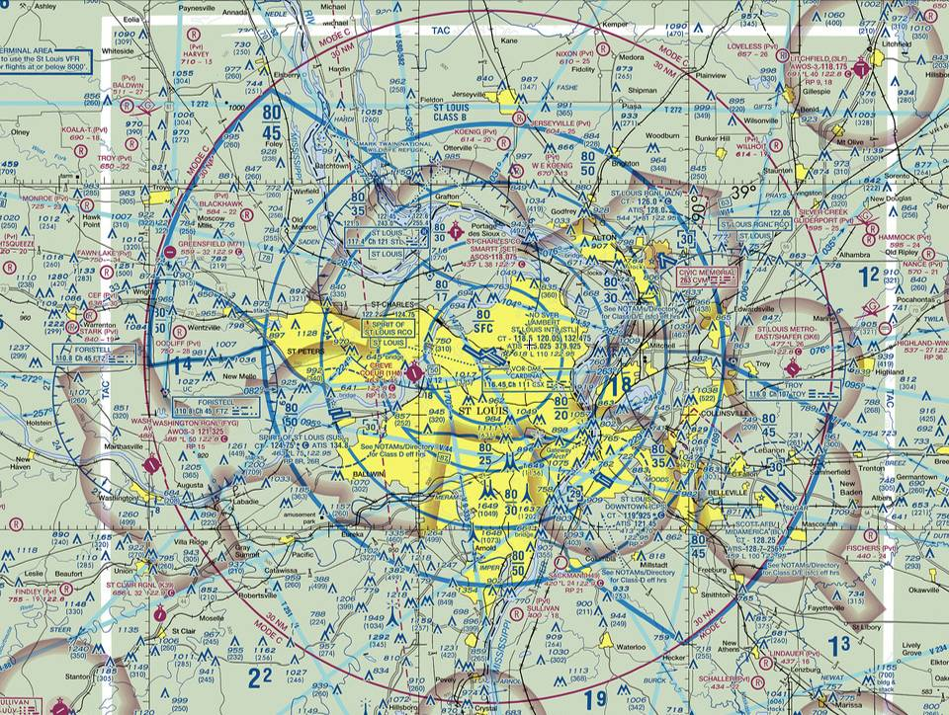
Identifying Airspaces (cont)
Class B
Class E
Class E
Class D
Class E
Class E
Class D
Class D
30 NM ‘Mode C’ line
Class E

Slide 14
Identifying Airspaces (cont)
Identifying Airspaces (cont)
PROHIBITED AREA

Slide 15
On-line Airspace Review http://www.skyvector.com/
Example here is KXNA, a Class C airport in NW AR with multiple Class D and various uncontrolled fields surrounding. Recommend instructors/students use the ‘World VFR’ (or e.g., Kansas City) ‘Sectional’ map button at the top right, to step through multiple examples of Class B, C, D, E-Surface, and G airports/airspaces around the nation. Discussion: Note how this newer airspace was designed with a wide encompassing Class E ‘dip’ around the controlled airports.

Slide 16
Review & Summary
Understand the U.S. National Airspace System
Be able to list and define all classes of U.S. airspace
Know VFR weather (visibility and cloud clearance), equipment, and ATC clearance requirements for each airspace
Be able to determine from a sectional map, what airspace a pilot is in at any point/altitude
Know sources for airspace study including Skyvector.com, The AIM, (and FARs Part 91, which is a later lesson)
Quiz to follow…

Slide 17
Questions?
Next Up: Navigation & Flight Planning
Ref: PHAK Chapter 16 & Skyvector.com

